Slide 1
Civil War 1860-65
1860-- Repub Abraham Lincoln (IL)
elected pres
1860 SC succession; then 1861 MS, FL,
AL, GA, LA, TX
Confederate States of America
Jefferson Davis (Pres); Richmond Capital
April, 1861—Confed attack on Fort Sumter
VA, NC, AR, TN join Confed
Lincoln
Davis

Slide 3
East: July, 1861—Manassas (Bull Run)
Gen. Robert E. Lee defends Richmond
Aug, 1862—2nd Battle of Bull Run
Sept. 1862—Antietam (First Union Vic)
Dec, 1862—Fredricksburg (confed)
May, 1863 Chancellorsville (confed)
West: Union Control Ohio, Miss, Missouri R.
Gen. Ulysses S. Grant victories Fort Henry; Fort Donelson
April, 1862 Shiloh (Confeds retreat)
Gen. Grant
Gen. Lee

Slide 5
April, 1862—Adm. David G. Farragut
captures New Orleans (Union)
Grant victorious at Vicksburg, MS; Port Hudson, LA
Cut off LA; AR; TX from East of Miss R.
July 1, 1863—Gettysburg, PA
Confeds retreat
Grant offensive in VA
June, 1864—Petersburg victory
Gen. William Tecumseh Sherman
July-Sept– Atlanta (GA)
“March to the Sea” –300 miles
Dec, 1864—Savannah (GA)
Feb, 1865—Columbia (SC)
April 9, 1865– Lee surrenders to Grant
Appomattox Court House, VA
260,000 Confed dead; 360,000 Union

Slide 6
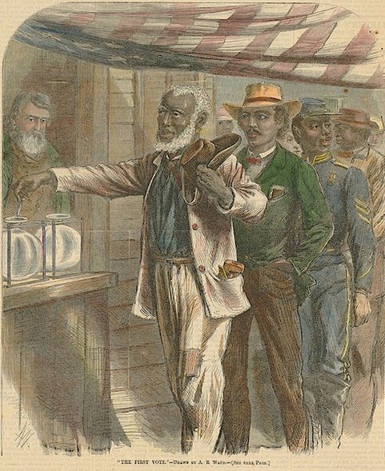
Reconstruction: 1863-77
1867 – Free Slaves Voting for the first time (Harper’s Magazine)

Slide 7
Wartime Reconstruction
President or Congress?
1863—Lincoln “Bind up the Nation’s Wounds”
Full pardon to rebels (property and political rights)
Who Renounce succession; accept emancipation
10% of state’s voting pop (oath of allegiance)
Pres. Lincoln

Slide 8
April, 1865—Lincoln assassinated
by John Wilkes Booth (Ford Theater)
VP Andrew Johnson (TN) and Presidential
Reconstruction
Key issue: transition from slavery to free labor
Pres. Johnson

Slide 9
Federal gov’t provided hope:
Mar, 1865, Freedman’s Bureau est.
Provide food, clothing, 40 acre plots

Slide 10
Presidential Reconstruction
Johnson--Defend State’s Rights (not secession)
Rapid restoration:
States renounce secession, ratify
13th amendment,
pardon ex-rebels
returned confiscated/abandoned land
Southern delegates resist
Est. Black Codes

Slide 11
Congressional Reconstruction:
Amend constitution; federal military intervention;
and Impeachment
Congress pass Civil Rights’ Act of 1866
14th amendment:
“due process of law”
“equal protection of the laws”
Woman’s suffrage?
Elizabeth Cady Stanton and Susan B. Anthony
Est. American Equal Rights Association (1866)
Stanton and Anthony

Slide 12
Johnson Resists Repubs:
Mob Violence: New Orleans; Memphis
1866 But Repubs victory in elections
Radical Reconstruction:
led by Charles Sumner (Mass);
Thaddeus Stevens (Penn)
14th amend refused in South (except TN)
Military Reconstruction Act (Mar, 1867)
5 military districts (union generals)
new state constitutions require:
black suffrage; ratify 14th amendment
Thaddeus Stevens

Slide 13
Veto (overrode by Congress)
Freedmen--Ballot and equal rights, but not land
Impeachment
Pardons; replace generals; attack Freedman’s Bureau
Aug, 1867 Edwin M. Stanton (sec of War) suspended
Tenure of Office Act (defiance of act)
House impeach; senate try
Supreme Court Justice (Salmon Chase) preside
One vote short
Truce (10 months remaining)
Summons of Impeachment

Slide 14
15th Amendment
Men right to vote nationally
Ratified Mar, 1870
Violence in the South:
led to rise of Rep party (South)
Inc. Enfranchised freedmen; Carpetbaggers;
and Scalawags
Klu Klux Klan (TN, 1866)
Harper’s Weekly, 1868

Slide 15
Jim Crow (segregation)
Sharecropping
Ulysses S. Grant pres in 1869; re-elected 1872
Scandals and economic depression (1873)
Klu Klux Clan Act, 1871
(protect repubs in South)
Civil Rights’ Act of 1875
Pres. Grant

Slide 16
Redeemer Counter-rev
Polarize parties Dem v. Rep (race and
economic hardship, esp. farmers)
Terrorism (towards Black Republicans)
Eg. Colfax Massacre (1873); LA
Democrats regain control
Carl Schurz “A Revolution but half accomplished”
Colfax Massacre

